Slide 1

General meeting 6/10 2022
Sjur Beyer

Slide 2
Overview

Slide 3
The Git environment
[fra the git env på paden]
Code for accessing the repo will be in the endnote on teams
You will need this code to set up the repo

Slide 4
Current status for the models
I have ran some 1D reconstruction models;
Focusing on getting good procedures for running the models on the servers
Profiling:
I did not get very good results for running on Odin. My laptop performed better; Probably because tf ran things in parallel on the laptop graphics processor (much better parallel compute)

Slide 5
Plan
Running models - meanwhile writing theory
Depending on results change things underway

Slide 6
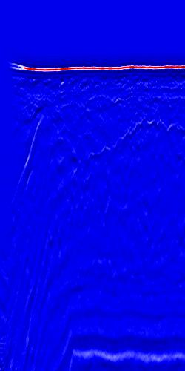
Data cleaning
The left-most side of the image contains some anomalous data which can throw off the ML training
These traces should be removed from the data set

Slide 7
Misc
Causal padding is not supported for Conv2D
Discussion around this

